Slide 1
Using the NOVEL Promotional Slides
1
Include any or all slides in your presentations to help promote NOVEL, the NANOS IC and NANOS NOTE
Steps to copy slides into your slide deck
Right-click the slide(s) in the left panel and click “Copy”
Navigate to the presentation you want to include the slide(s) in and right-click and “Paste – Keep Source Formatting”
Edit text if necessary for your audience but be sure to keep the contact information present!
Thank you for doing your part in promoting NOVEL!
2

Slide 2
Neuro-Ophthalmology Virtual Education Library (NOVEL)
NANOS Illustrated Curriculum (IC)
Created by NANOS Curriculum and NOVEL Committees
Includes Walsh & Hoyt Textbook, 6th Edition
Includes NANOS Examination Techniques (NExT)
2,234 files of neuro-ophthalmology learning materials, organized by curriculum outline
Available on STAT!Ref via license.
Ask your library to purchase.
Contact Teton Data Systems
statref.com
800-901-5495
theteam@tetondata.com

Slide 3
Neuro-Ophthalmology Virtual Education Library (NOVEL)
Neuro-Ophthalmology Techniques of Examination
For NON-Neuro-Ophthalmologists (NOTE)
Focus on examination techniques
Specifically for NON-neuro-ophthalmologist health care providers
Unique learning product developed by surveying 247 non-neuro-ophthalmologist health care providers
Available on STAT!Ref via license.
Ask your library to purchase.
Contact Teton Data Systems
statref.com
800-901-5495
theteam@tetondata.com

Slide 4
Neuro-Ophthalmology Virtual Education Library (NOVEL)
NOVEL.utah.edu
Collection of 20,000 neuro-ophthalmology learning materials peer-reviewed by NANOS NOVEL Editorial Board
Proceedings of the NANOS Annual Meeting & JNO
Contributions from NANOS members encouraged!
Current Gaps: https://novel.utah.edu/submissions
NANOS Member
Opportunities
Participate on committees
Publish learning materials
Contribute to NANOS’ goals
Contact the NOVEL team
novel@lists.utah.edu

Slide 5
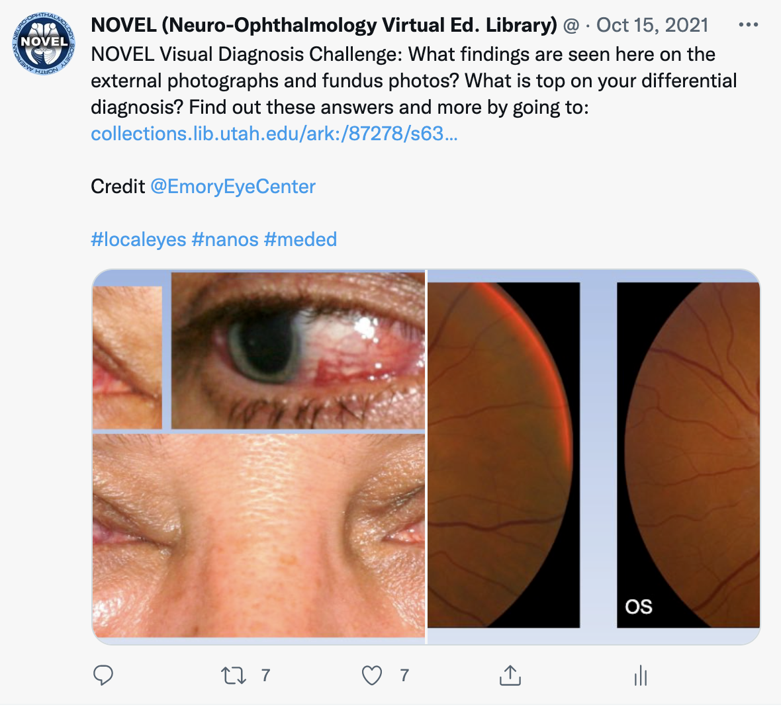
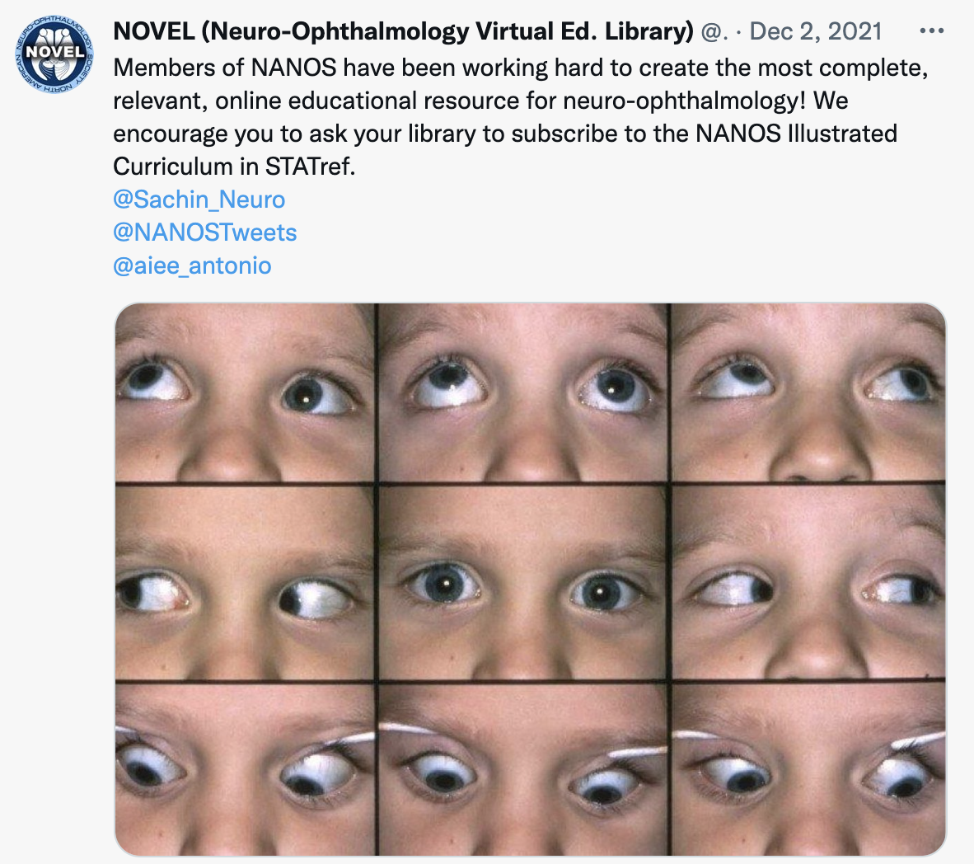
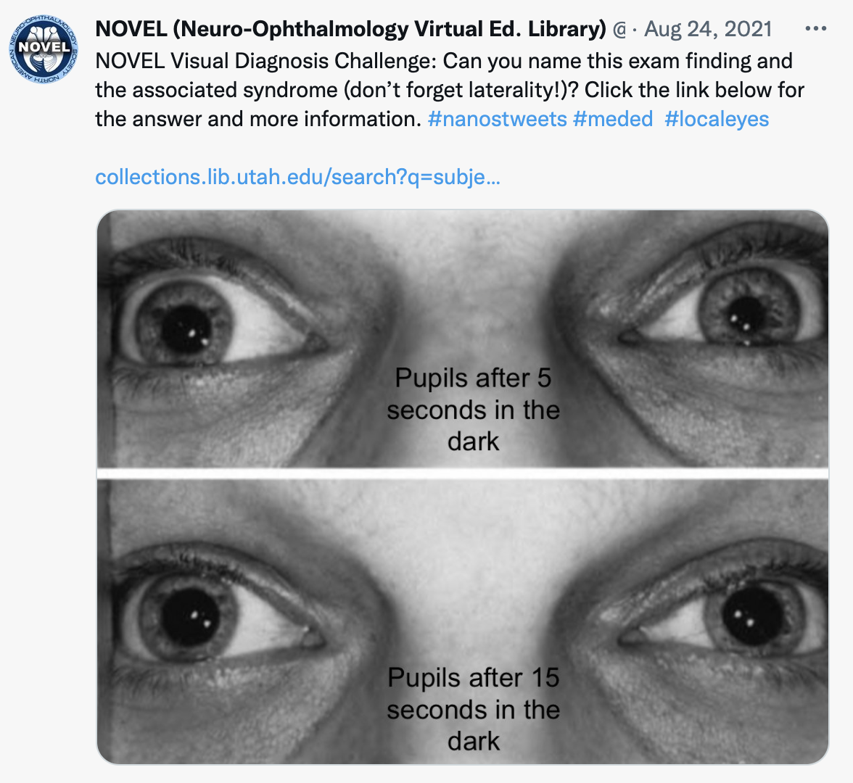
Neuro-Ophthalmology Virtual Education Library (NOVEL)
Follow @NOVELNANOS

